Slide 1
Vision-Based Navigation
For a Voice Controlled Quadrotor

Slide 2

Introduction
In this work we implemented a quadrotor control system based on visual features.
We used ARTag tool to estimate the quadrotor position and orientation in the space.
On top of it we enabled the robot to execute spoken command through a voice user interface (VUI).
An example of ARTag marker

Slide 3
General System Architecture
Gazebo-Simulation/Quadrotor Controller
AR_Pose
LCM Server/Broker
Decision and Learning Module
Android Application
ARToolkit

Slide 4
Vision-Based Navigation
Pose estimation using a camera and ARTag

Slide 5
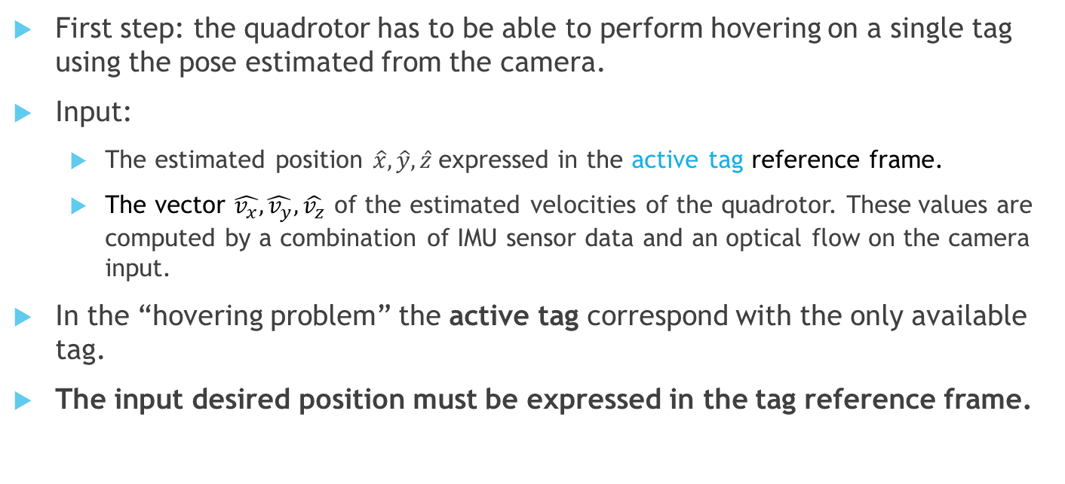
The Hovering Problem
First step: the quadrotor has to be able to perform hovering on a single tag using the pose estimated from the camera.
Input:
The estimated position $\hat{x},\hat{y},\hat{z}$expressed in the active tag reference frame.
The vector $\hat{v_{x}}\hat{,v_{y},}\hat{v_{z}}$ of the estimated velocities of the quadrotor. These values are computed by a combination of IMU sensor data and an optical flow on the camera input.
In the “hovering problem” the active tag correspond with the only available tag.
The input desired position must be expressed in the tag reference frame.

Slide 6
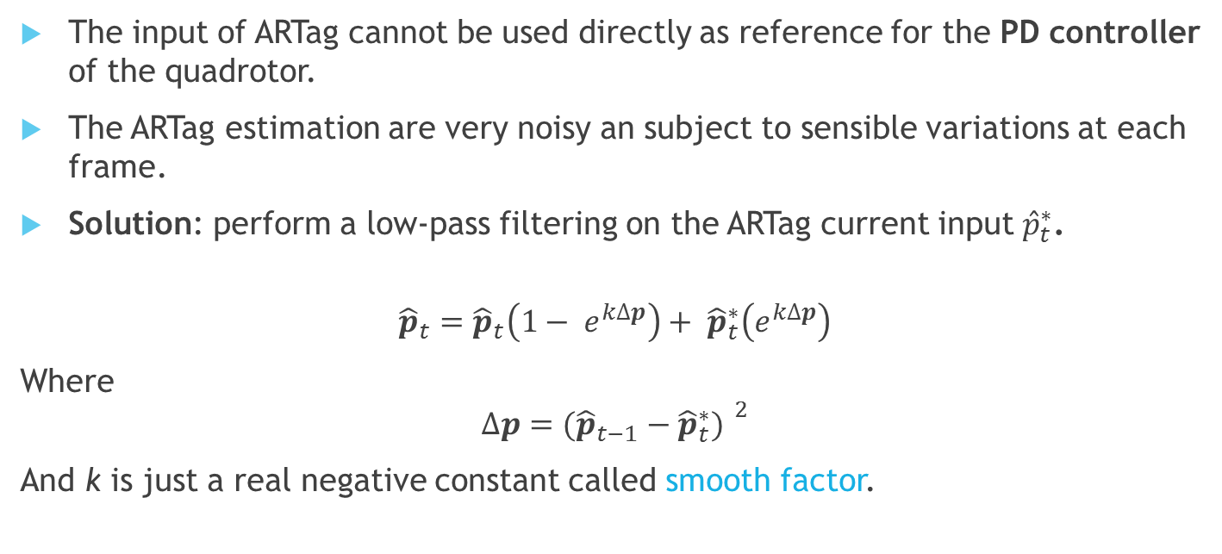
Smoothing in the Pose Estimation
The input of ARTag cannot be used directly as reference for the PD controller of the quadrotor.
The ARTag estimation are very noisy an subject to sensible variations at each frame.
Solution: perform a low-pass filtering on the ARTag current input ${\hat{p}}_{t}^{∗}$.
$${\hat{p}}_{t}={\hat{p}}_{t}\left(1− e^{k∆p}\right)+ {\hat{p}}_{t}^{∗}\left(e^{k∆p}\right)$$
Where
$$∆p={({\hat{p}}_{t−1}−{\hat{p}}_{t}^{∗}) }^{2}$$
And k is just a real negative constant called smooth factor.

Slide 7
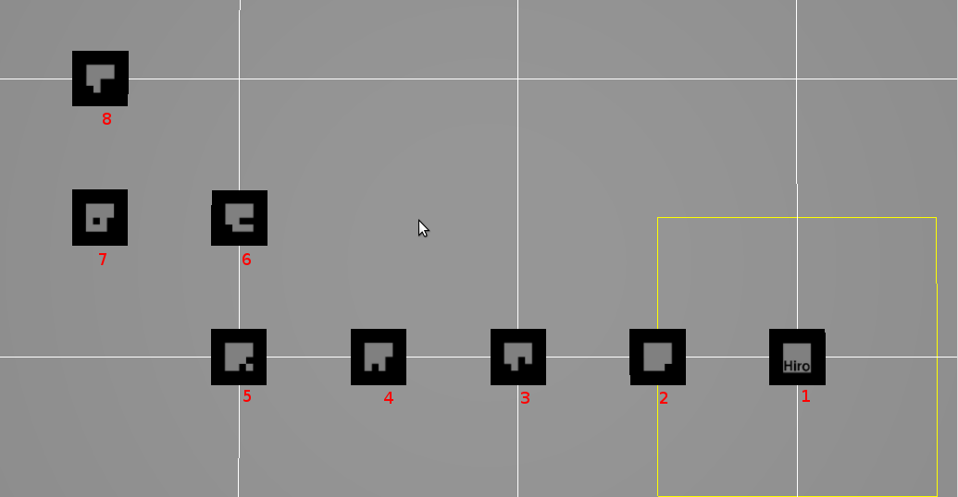
The Navigation Problem – 1/2
Now we add more tags to make possible for the quadrotor to follow a path.

Slide 8
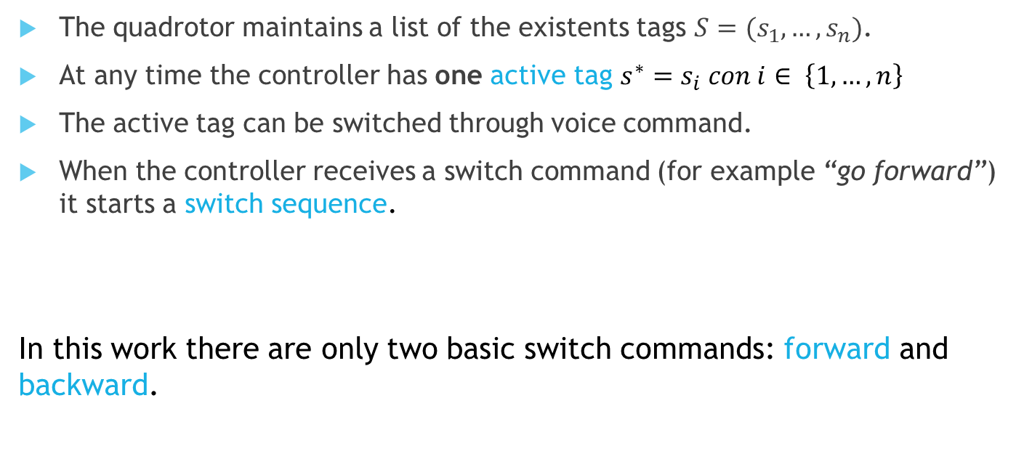
The Navigation Problem - 2/2
The quadrotor maintains a list of the existents tags $S=(s_{1},…,s_{n})$.
At any time the controller has one active tag $s^{∗}=s_{i} con i∈ \left\{1,…,n\right\}$
The active tag can be switched through voice command.
When the controller receives a switch command (for example “go forward”) it starts a switch sequence.
In this work there are only two basic switch commands: forward and backward.

Slide 9

The Switching Sequence
Suppose that the switch command is $switchTo(s_{j})$.
The switching sequence is composed by three steps:
Search for the given tag in the camera image
Switch tag and update the desired position
Drag the desired position back to its original value

Slide 10
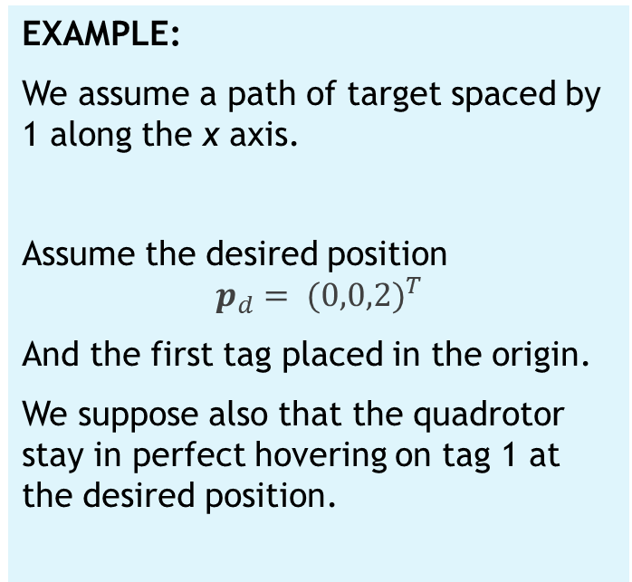

The Switching Sequence Step 1
Current active tag = $s_{i}$
Search in the camera image for the tag $s_{j}$.
If you have found it, go to Step 2.
EXAMPLE:
We assume a path of target spaced by 1 along the x axis.
Assume the desired position
$$p_{d}= {(0,0,2)}^{T}$$
And the first tag placed in the origin.
We suppose also that the quadrotor stay in perfect hovering on tag 1 at the desired position.
1
2
3
n

Slide 11
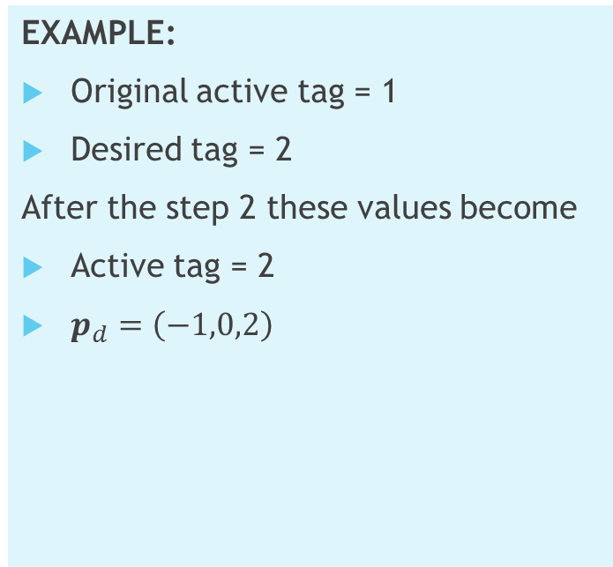
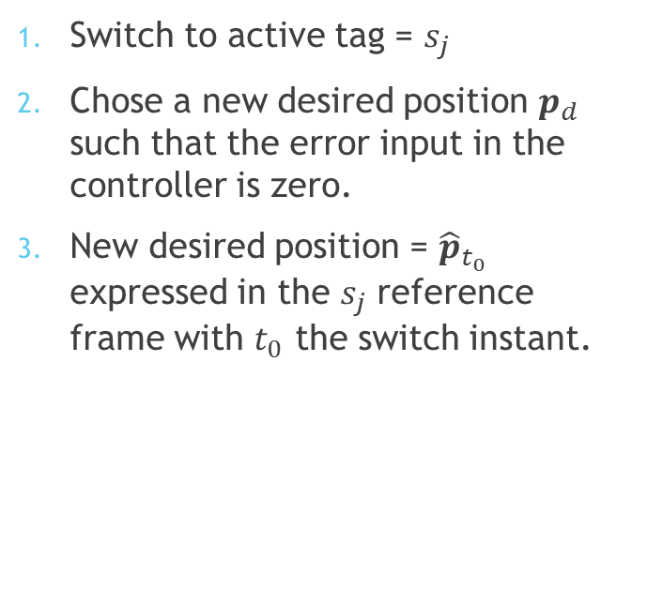
The Switching Sequence Step 2
Switch to active tag = $s_{j}$
Chose a new desired position $p_{d}$ such that the error input in the controller is zero.
New desired position = ${\hat{p}}_{t_{0}}$ expressed in the $s_{j}$ reference frame with $t_{0}$ the switch instant.
EXAMPLE:
Original active tag = 1
Desired tag = 2
After the step 2 these values become
Active tag = 2
$p_{d}=\left(−1,0,2\right)$

Slide 12
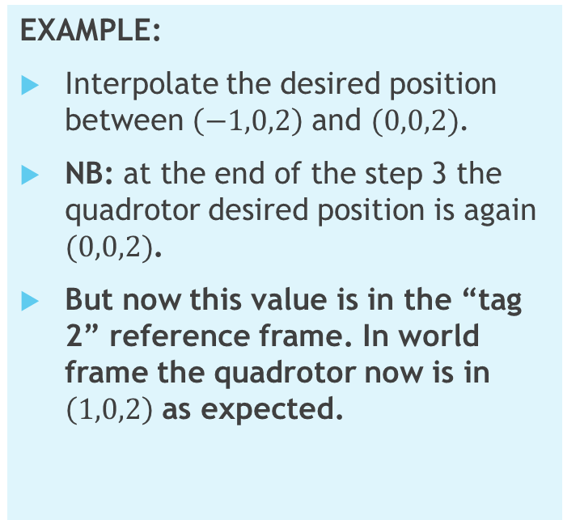
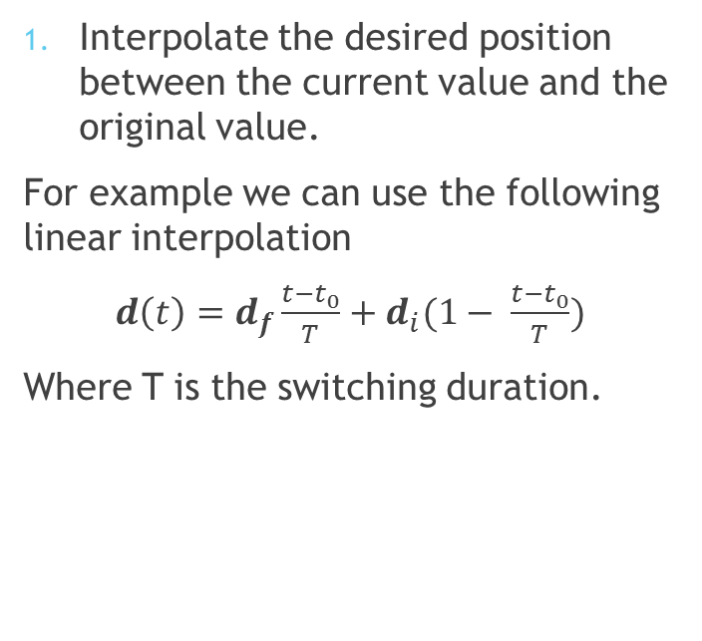
The Switching Sequence Step 3
Interpolate the desired position between the current value and the original value.
For example we can use the following linear interpolation
$d\left(t\right)=d_{f}\frac{t−t_{0}}{T}+d_{i}(1− \frac{t−t_{0}}{T})$
Where T is the switching duration.
EXAMPLE:
Interpolate the desired position between $\left(−1,0,2\right)$ and $(0,0,2)$.
NB: at the end of the step 3 the quadrotor desired position is again $(0,0,2)$.
But now this value is in the “tag 2” reference frame. In world frame the quadrotor now is in $\left(1,0,2\right)$ as expected.

Slide 13
Voice Control
Robust understanding and on-line learning

Slide 14
Robust Speech Recognition Problem
Speech recognition is intrinsically noisy.
Input:
A set of possible transcriptions for the given command.
We need to correctly infer the right command from a set of possible transcriptions.
When the inference fails we need a recovery strategy.

Slide 15

Automated Speech Recognition
Google ASR for free-form speech recognition
Implementation of Android app to use Google API
Use of LCM to enable communication between the input device and the robot

Slide 16
Command and Noise
COMMAND | Explanation
FORWARD | Move to the following tag
BACK | Move to the previous tag
LAST | Go to the end of the path
FIRST | Go to the beginning of the path
STOP | Stop on the current tag
Given Command | Interpretations
FORWARD | for work 4 work for work Fort Worth
BACK | BAC bak Mac

Slide 17
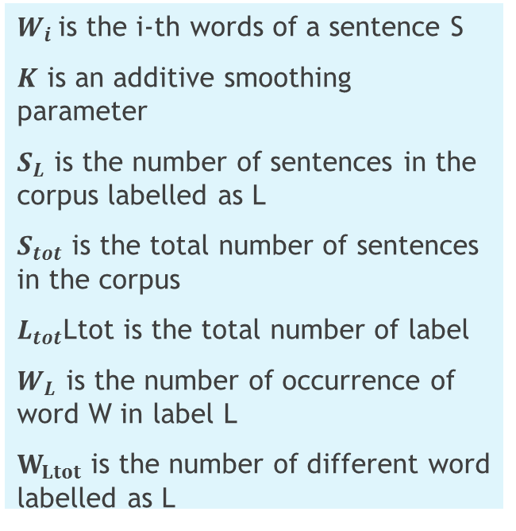
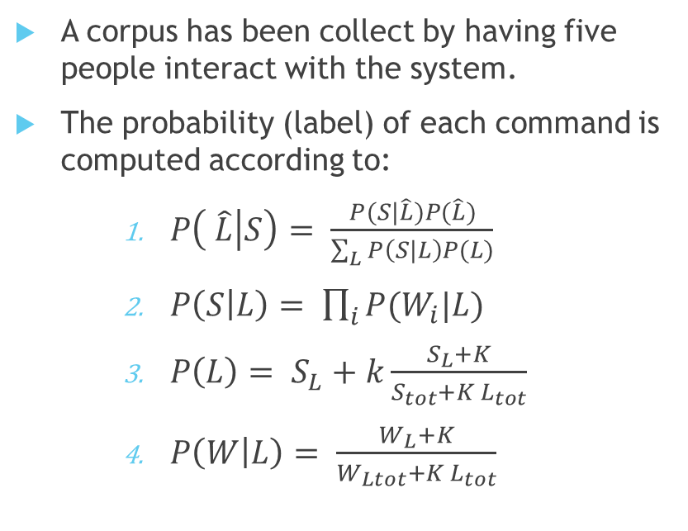
Bayesian Classification
A corpus has been collect by having five people interact with the system.
The probability (label) of each command is computed according to:
$P\left( \hat{L} | S\right)= \frac{P(S|\hat{L})P(\hat{L})}{\sum_{L}{P\left(S|L\right)P(L)}}$
$P\left(S | L\right)= \prod_{i}{P(W_{i}|L)}$
$P\left(L\right)= S_{L}+k\frac{S_{L}+K}{S_{tot}+K L_{tot}}$
$P\left(W | L\right)= \frac{W_{L}+K}{W_{Ltot}+K L_{tot}}$
$W_{i }$is the i-th words of a sentence S
$K$ is an additive smoothing parameter
$S_{L}$ is the number of sentences in the corpus labelled as L
$S_{tot}$ is the total number of sentences in the corpus
$L_{tot}$Ltot is the total number of label
$W_{L}$ is the number of occurrence of word W in label L
$W_{Ltot}$ is the number of different word labelled as L

Slide 18
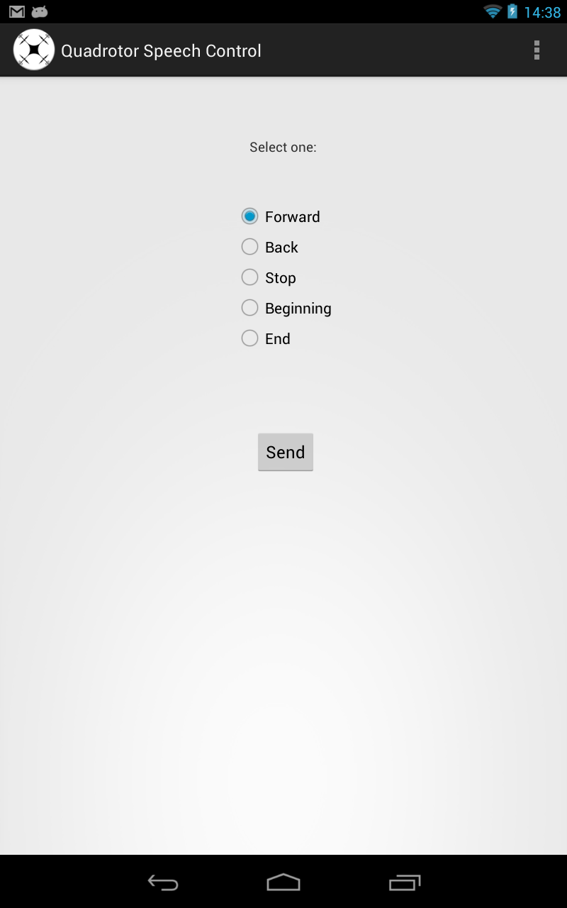
On-Line Learning
When the inference fails a recovery procedure is needed:
The robot ask the user to specify what the intended command was.
All the interpretations are added to the corpus with the correct label
This procedure allows to learn possible new expression for the five commands defined.

Slide 19
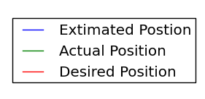
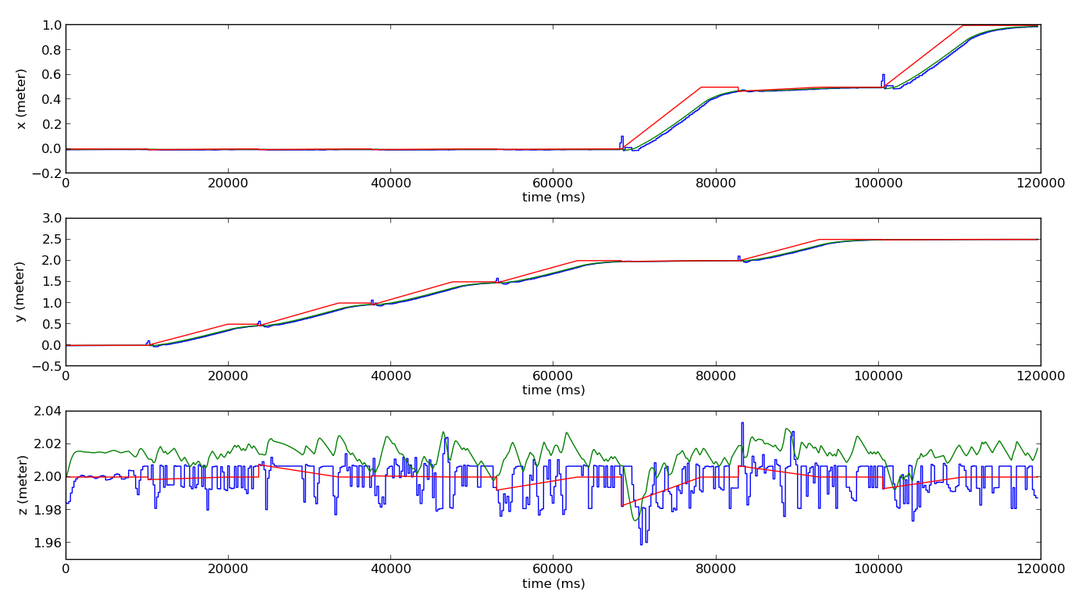
Simulation 1/2

Slide 20
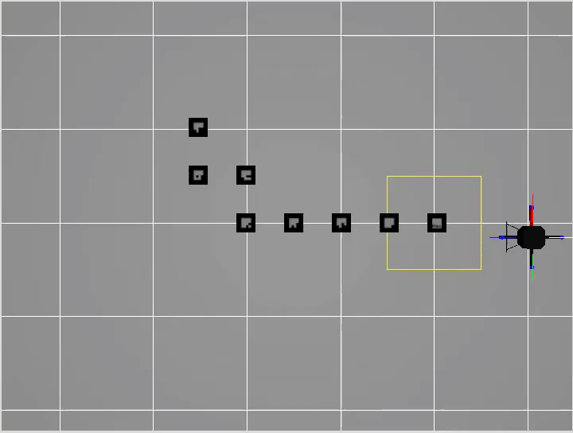
Simulation 2/2

Slide 21
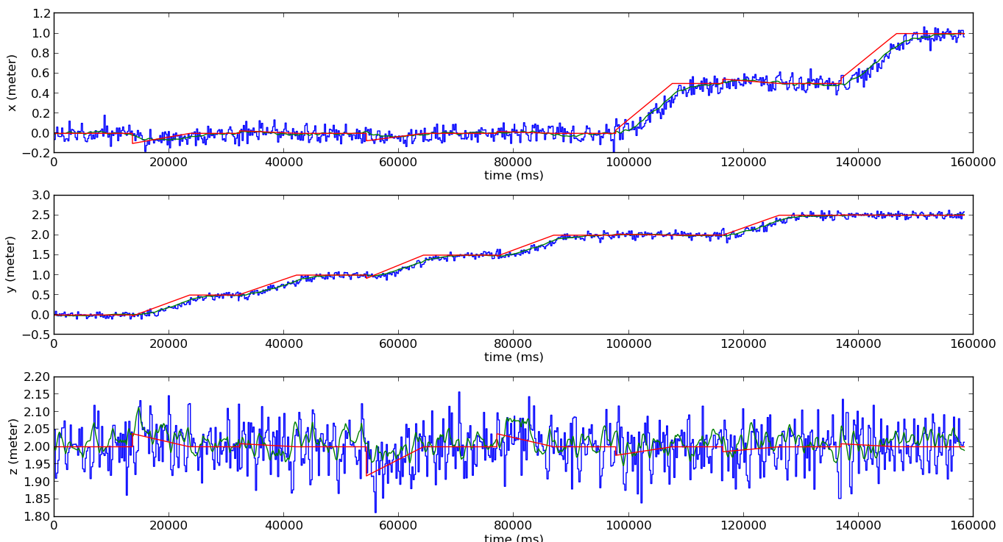
Simulation with added noise 1/2

Slide 22
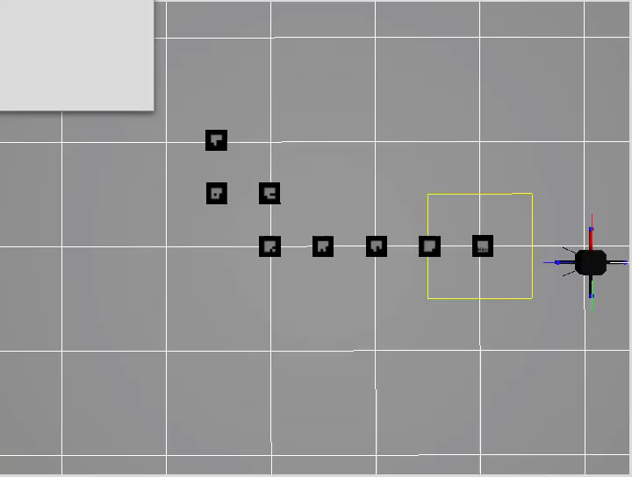
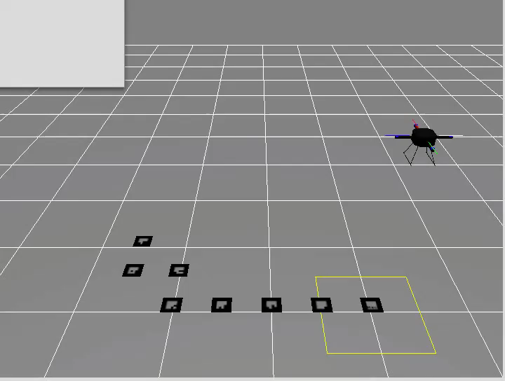
Simulation with added noise 2/2

